Slide 1
Modules in Python
Unit 4.2
Cybersecurity Boot Camp |

Slide 2
Today’s Goals
By the end of class, you will be able to:
Import the string, random, and hashlib modules to access the functions within them.
Use the csv module to read and write data to CSV files.
Use the secrets module to generate random passwords.
Use the os module to create file paths and check for specific files.
Use the os module to navigate through a folder system and automate tasks.
Use the os module to perform a simple attack on an operating system.
Notes:
Review goals; address any questions.

Slide 3


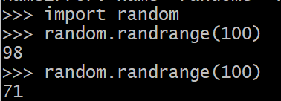
Built-In Modules
Modules are a combination of functions and other pieces of code – put together to be “reused”
Built-in modules help avoid re-inventing the wheel
The `csv` module allows users to more easily work with external CSV files
The `os` module allows users to work with the operating system
The `datetime` module contains functions for manipulating dates and times
Before you can use a module, it must be imported
Notes:
Review goals; address any questions.

Slide 4
Activity: Module Hunter (10 min)
  You’ve been given a worksheet that asks you to import modules and perform tasks using functions in that module.
  Instructions:
  Using The Python Standard library as a reference and the provided file as your guide, import all the modules requested and then complete the tasks listed within the comments.
  To get you started, we've provided you with the first module that you will be importing.
  Hint: If you get stuck on a problem, remember that there are other sources of information online that may help to clear up the confusion.

Slide 5
Module Hunter
Instructor Review

Slide 6
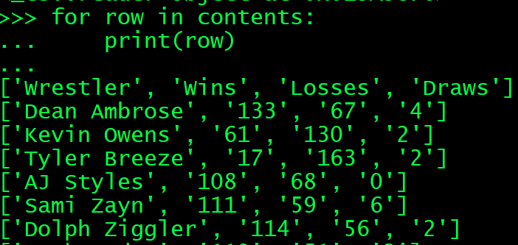
CSV Module
The CSV module reads and writes tabular data
Uses `reader` and `writer` objects to read and write
  import csv
  csvFile = open("WWE-Data.csv")
  contents = csv.reader(csvFile)
  for row in contents:
    print(row)
Notes:
Instead of using `file.read()` to read the contents, we use the `csv.reader(file)` method.
The `csv.reader()` method automatically splits the contents of the external file into rows whenever there is a newline character and cells whenever there is a comma.

Slide 7
Today’s Goals
By the end of class, you will be able to:
Import the string, random, and hashlib modules to access the functions within them.
Use the csv module to read and write data to CSV files.
Use the secrets module to generate random passwords.
Use the os module to create file paths and check for specific files.
Use the os module to navigate through a folder system and automate tasks.
Use the os module to perform a simple attack on an operating system.
Notes:
Review goals; address any questions.

Slide 8
Activity: User List Revisit (10 min)
Instructions:
The provided script contains the original solution from the last class. You must modify it so that it uses the CSV module to read through and parse the external data instead of requiring manual splitting.
Modify the script so that, instead of printing out information to the screen, it instead pushes this information into a new text file called PeopleToKeepEyesOn.txt.
Hint: One manual split will be necessary in the completed application since the list of IP addresses is still contained within a single cell.

Slide 9
User List Revisit
Instructor Review

Slide 10
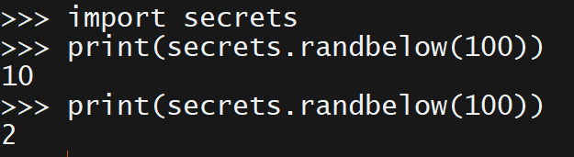
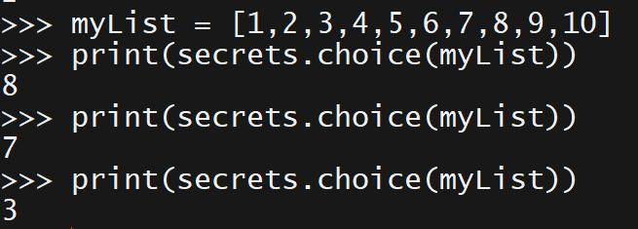
Secrets Module
From Python Docs:
  The secrets module is used for generating cryptographically strong random numbers suitable for managing data such as passwords, account authentication, security tokens, and related secrets.
Notes:
Secrets module should be used in preference to the default pseudo-random number generator in the random module, which is designed for modelling and simulation, not security or cryptography

Slide 11
Today’s Goals
By the end of class, you will be able to:
Import the string, random, and hashlib modules to access the functions within them.
Use the csv module to read and write data to CSV files.
Use the secrets module to generate random passwords.
Use the os module to create file paths and check for specific files.
Use the os module to navigate through a folder system and automate tasks.
Use the os module to perform a simple attack on an operating system.
Notes:
Review goals; address any questions.

Slide 12
Activity: Random Password List (20 min)
In this activity, you will generate a list of 100 random passwords using the secrets module and push each individual element into an external file.
Instructions:
Import both the secrets and string libraries into the application.
Create a string that will hold all of the ASCII characters and digits inside of it.
Create a connection to an external text file called PasswordList.txt.
Create a loop that will run for 100 iterations and will push a new, 10 character password of random letters/numbers into the external file.

Slide 13
Random Password List Review
Instructor Review

Slide 14
Today’s Goals
By the end of class, you will be able to:
Import the string, random, and hashlib modules to access the functions within them.
Use the csv module to read and write data to CSV files.
Use the secrets module to generate random passwords.
Use the os module to create file paths and check for specific files.
Use the os module to navigate through a folder system and automate tasks.
Use the os module to perform a simple attack on an operating system.
Notes:
Review goals; address any questions.

Slide 15
BREAK

Slide 16
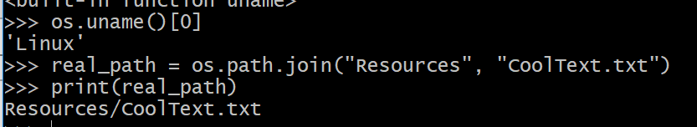
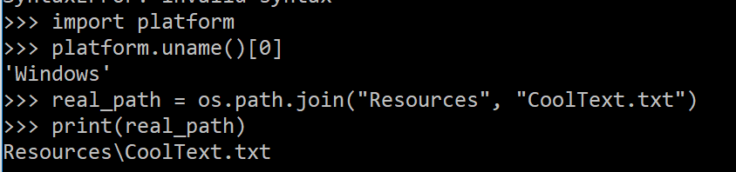
OS Module
From Python Docs:
  This module provides a portable way of using operating system dependent functionality.
For example, Unix-like OS and Windows use different slashes (\ vs /) to join paths. Python’s os.path.join() takes care of this:
  real_path = os.path.join("Resources", "CoolText.txt")

Slide 17
Activity: Terminal Library (15 min)
In this activity, you have been given a Books folder that contains text files. You’ll need to create a program that prompts the user for a file name and then searches the Books folder for it.
Instructions:
Unzip the Books folder.
Create an application that will ask the user for the name of a text file, and then checks to see if the file exists in the Books folder.
  If the text file exists, then print the text inside of the file to the terminal.
  If the text file does not exist, then print "Sorry! That book is not in our records! Please try again!”
Hint: When the user enters the file name, keep in mind that they will not use a file extension (.txt). Therefore, when you’re creating your file path, remember that you’ll need to have the file extension added to that user input.

Slide 18
Terminal Library
Instructor Review

Slide 19
Today’s Goals
By the end of class, you will be able to:
Import the string, random, and hashlib modules to access the functions within them.
Use the csv module to read and write data to CSV files.
Use the secrets module to generate random passwords.
Use the os module to create file paths and check for specific files.
Use the os module to navigate through a folder system and automate tasks.
Use the os module to perform a simple attack on an operating system.
Notes:
Review goals; address any questions.

Slide 20
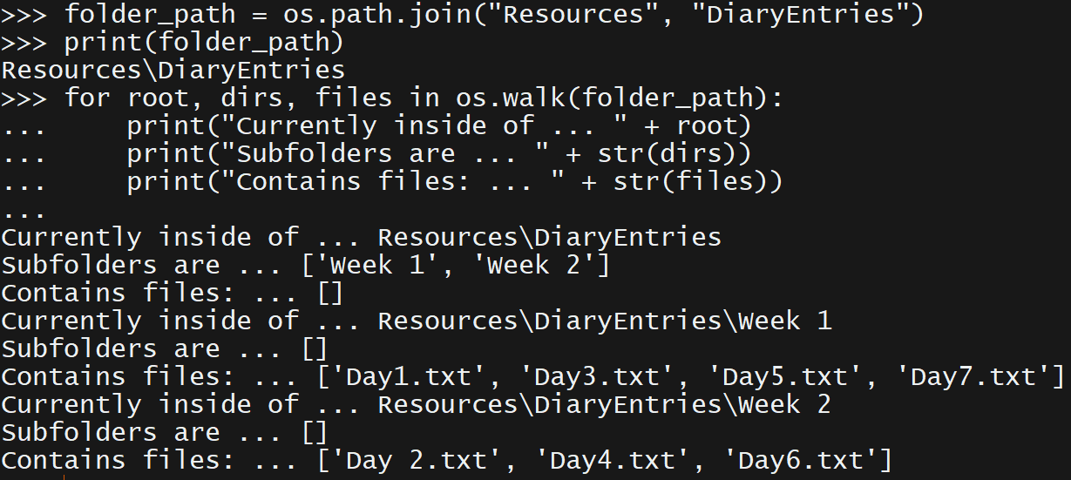
os.walk()
From Python Docs:
  Generates the file names in a directory tree by walking the tree either top-down or bottom-up.
  Syntax:
    os.walk(top, topdown=True, onerror=None, followlinks=False)
    Notice that only “top” value is required
  Returns:
    Directory path, directory names, and file names

Slide 21
Activity: Get Wrekt! (20 min)
In this activity, you will be taking on the role of a hacker. Your task as the hacker is to overwrite the victim’s files with the phrase "GET WREKT!”
Important!
  Do not run this application inside any important folders that you don't want to be overwritten. Make sure that your application only walks through the Diaries folder before adding the file.write() function in.
  You can also replace the file.write() function with file.read() instead. This way the program will only read in the data stored within the files instead of overwriting anything.
Instructions:
Unzip the folder.
Create an application that will check the Diaries folder that you just unzipped and automatically navigates through all of its subdirectories and files.
Have the application print the current root that it is walking through.
Have the application print out all the folders within the current root.
Have the application print out all the files within the current root.
Have your application automatically connect to each of the text files stored within this folder system and replace their text with the phrase "GET WREKT SKRUB!"

Slide 22
Get Wrekt!
Instructor Review

Slide 23
Today’s Goals
By the end of class, you will be able to:
Import the string, random, and hashlib modules to access the functions within them.
Use the csv module to read and write data to CSV files.
Use the secrets module to generate random passwords.
Use the os module to create file paths and check for specific files.
Use the os module to navigate through a folder system and automate tasks.
Use the os module to perform a simple attack on an operating system.
Notes:
Review goals; address any questions.

